Slide 1
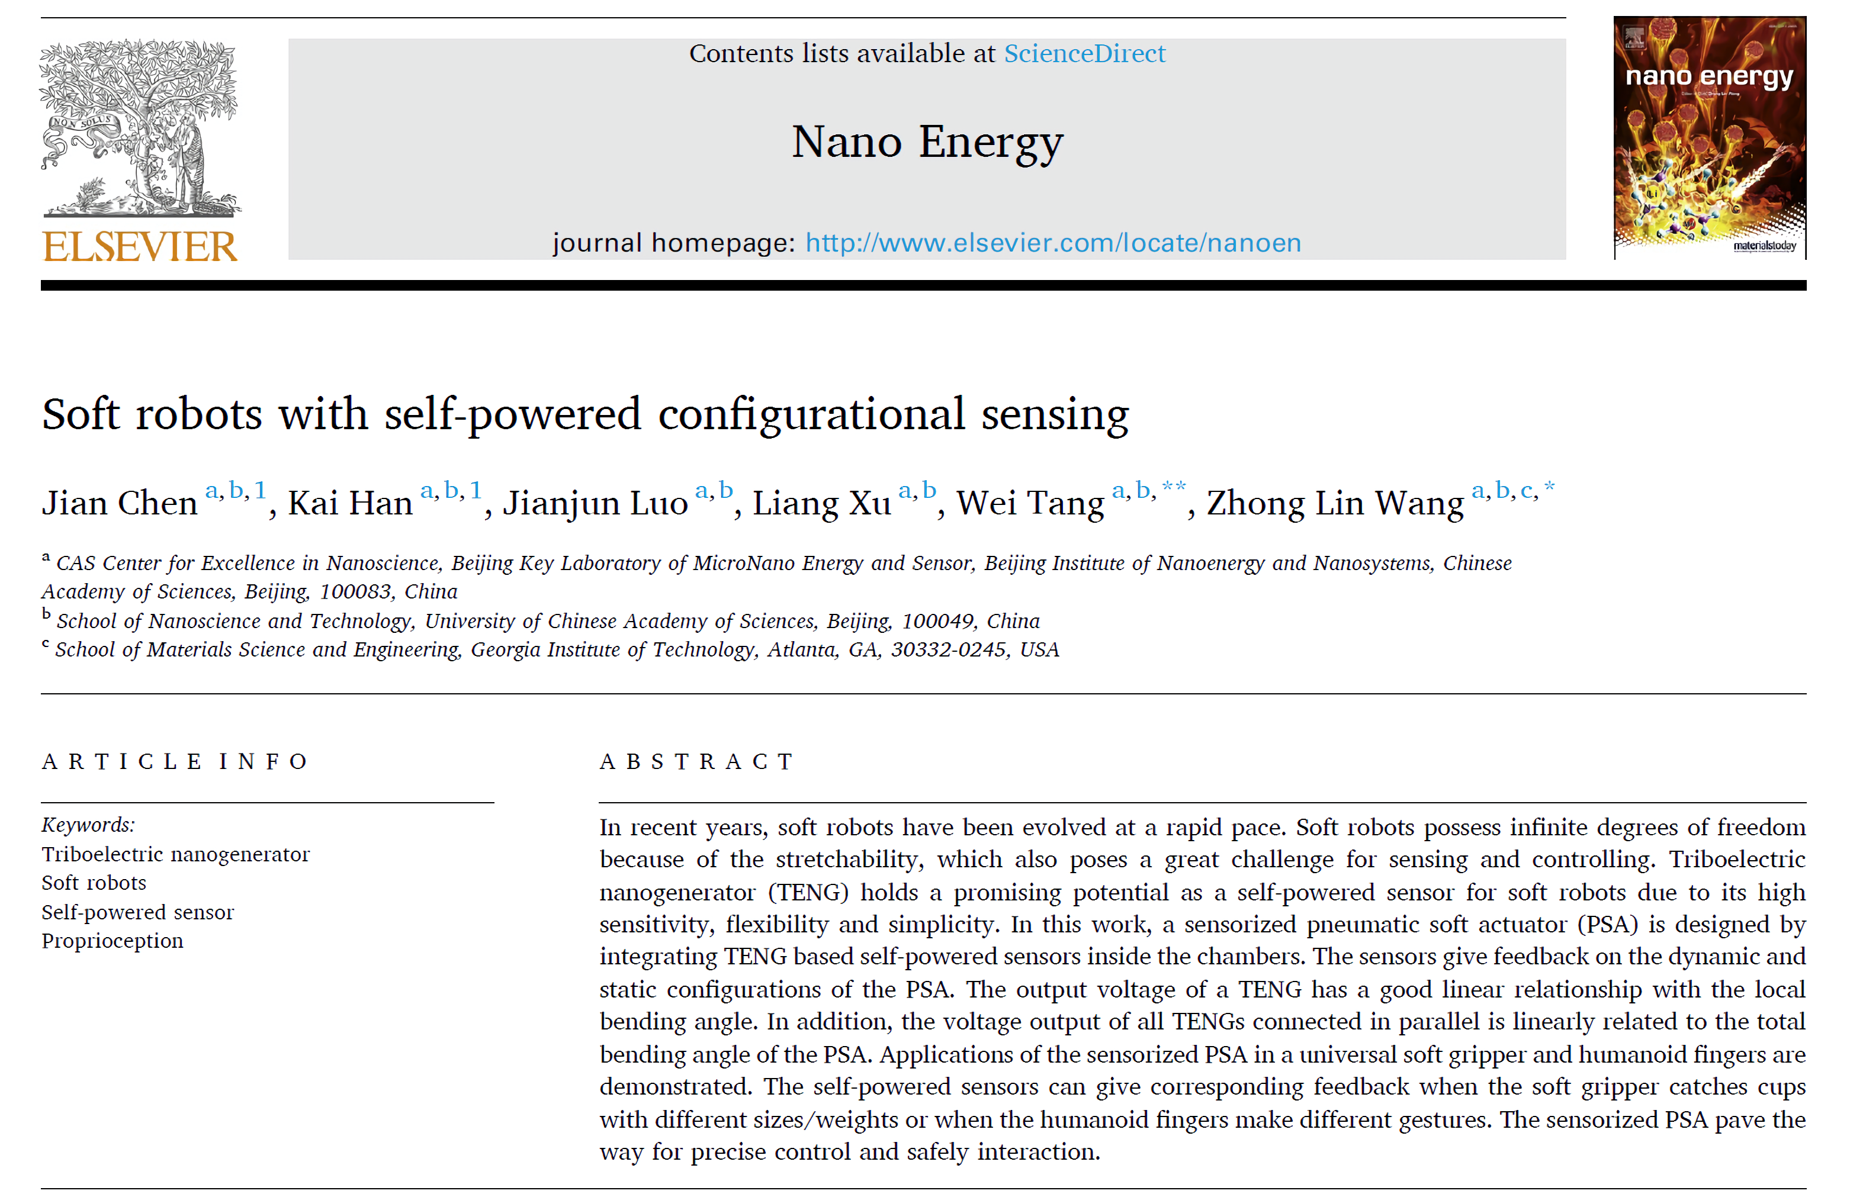

Soft Robots With Self-Powered Configurational Sensing^{[1]}
Presented by Austin Routt
Notes:
Good afternoon, class. Thank you for coming.
I’m Austin Routt and today I’ll be presenting my interpretation of Jian (Jee-on) Chen et al.’s research in Soft Robots With Self-Powered Configurational Sensing.

Slide 2
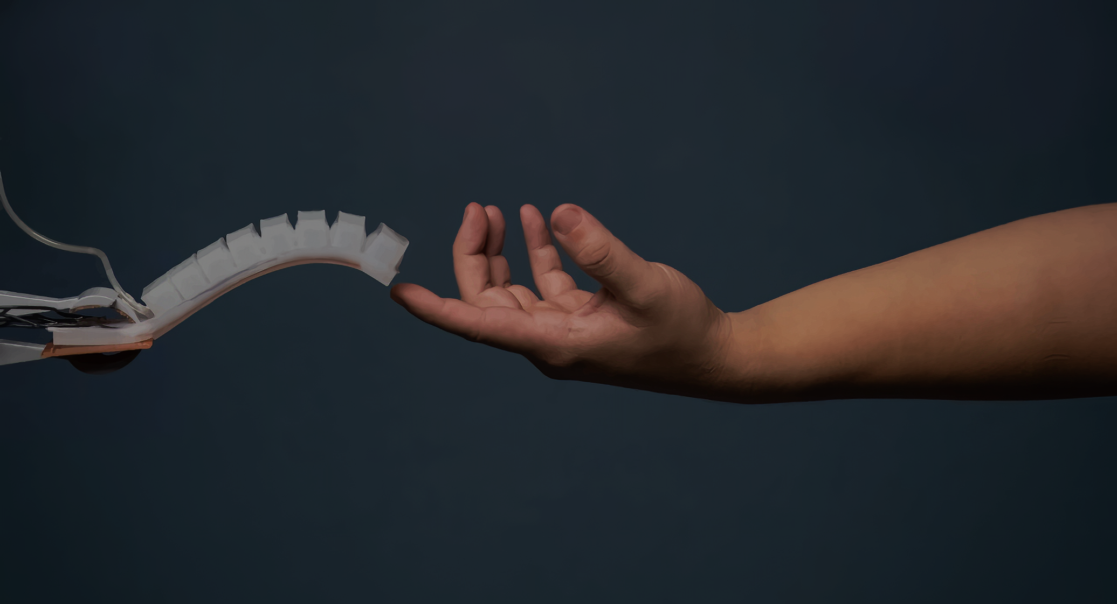




MATERIALS & METHODS
QUESTIONS & ANSWERS
INTRODUCTION & BACKGROUND
RESULTS & DISCUSSION
Notes:
Before I begin, please be aware that all of you have access to these slides via the GitHub link I posted in the chat window. I’ve put this under the Free Art license, so anyone is free to take, change, and/or repackage these slides at their own discretion. Also, my notes are in these slides, so I recommend you download them if you have trouble following my voice.
Now, let’s start with an introduction and some background.

Slide 3




INTRODUCTION & BACKGROUND
Notes:
To properly understand and then judge this article, we need to answer three questions:
1) Who are these researchers and are they credible?
2) What is the problem?”
3) How does this particular study address it?”

Slide 4

Reputable Institutions
Chinese Academy of Sciences (CAS)
#1 Nature Index Ranking^{[2]}
Georgia Institute of Technology (GIT)
#89 Nature Index Ranking^{[2]}
WHO?
Corresponding Authors
Dr. Wei Tang
Professor at Beijing Institute of Nanoenergy and Nanosystems
Prof. Zhong Lin Wang
Distinguished Professor at GIT
Pioneered Nanogenerators and self-powered sensors^{[3]}
CRediT (Contributor Roles Taxonomy)
Methodology, Supervision, Writing - review & editing
Who are these researchers and are they credible?
No Competing Interests
Notes:
So, who are these people and why should we believe them?
Interestingly, this study was the contribution of two reputable institutions, namely the Chinese Academy of Science and Georgia Tech. Although there are many ways to judge reputation in research, nature Index ranking offers us a straightforward metric that denotes scientific output in leading journals. As you can see, both intuitions are known contributors to high-quality scientific research.
That being said, the reputation and credentials of contributing authors is arguably more important than the institutions that back them. Here we find two contributing authors , one for each institution, and Dr. Tang and Professor Wang were kind enough to clearly define their roles using “Contributor Roles Taxonomy.” Here, one should focus on the fact that Professor Wang pioneered the field of Nanogenerators and self-powered sensors and , judging by their CRediT, both authors were highly involved in this study.
Finally, we note that the researchers declared no competing interests.
Thus, given the reputation of the supervising researchers and the institutions that back them, as well as the fact that they had no known competing interests, we should accept their article as truth until proven otherwise.

Slide 5

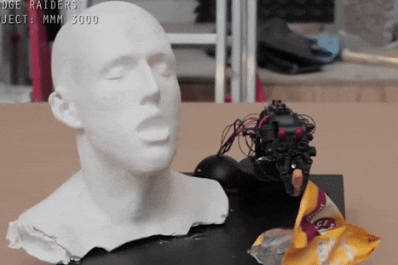

Hard
No Proprioception
WHAT?
What is the problem?
[4]
Not Safe
or Adaptable
Human-Machine Interaction Requires:
Safety
Adaptability
Notes:
Now that we have accepted these authors as credible, we need to understand their motivation by determining what problem they were trying to solve.
Judging from this slide’s video, I think the problem is clear: Essentially, conventional robots are hard, and those with without proprioception, or bodily awareness, are dangerous because they can’t adapt to their environment.

Slide 6



Pneumatic Soft Actuators (PSA)
HOW?
Sensorized PSA
How does this study address the problem?
Notes:
So, how did these researchers address the problem of designing safe and adaptable human-machine interaction?
They do it through a combination of Pneumatic Soft Actuators (PSAs) and Triboelectric Nanogenerators (TENGs). This creates a simple & inexpensive self powered sensor capable of giving soft robots the proprioception they need to be both safe and adaptable.
But what’s a TENG you ask? Good question! Let's zoom in on that concept.

Slide 7

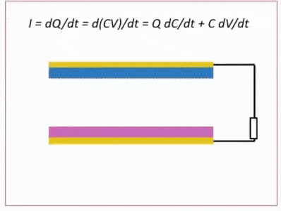
Contact-Separation Mode
Contact Causes Charge Transfer
Separation Causes Potential Difference
Electrons flow through the external load
Subsequent press causes current flow in opposite direction
Contact Electrification
(Triboelectric Effect)
Electrostatic Induction
Notes:
There are a few modes of operation, but this paper uses TENGs in Contact-Separation Mode. In this case, silicone is electronegative and draws charge away from a nickel sponge electrode when in contact. As the materials separate, they generate an electric field in between, which induces a potential difference. Electrons then flow from one electrode to the other through the external load until balance is achieved. When pressed again, transferred charges flows back through the external load, and a current pulse is generated in the opposite direction. If this is done periodically, you get alternating current.

Slide 8



MATERIALS & METHODS

Slide 9

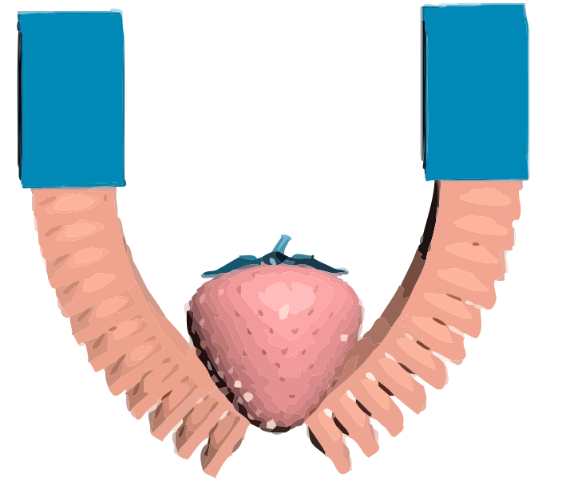
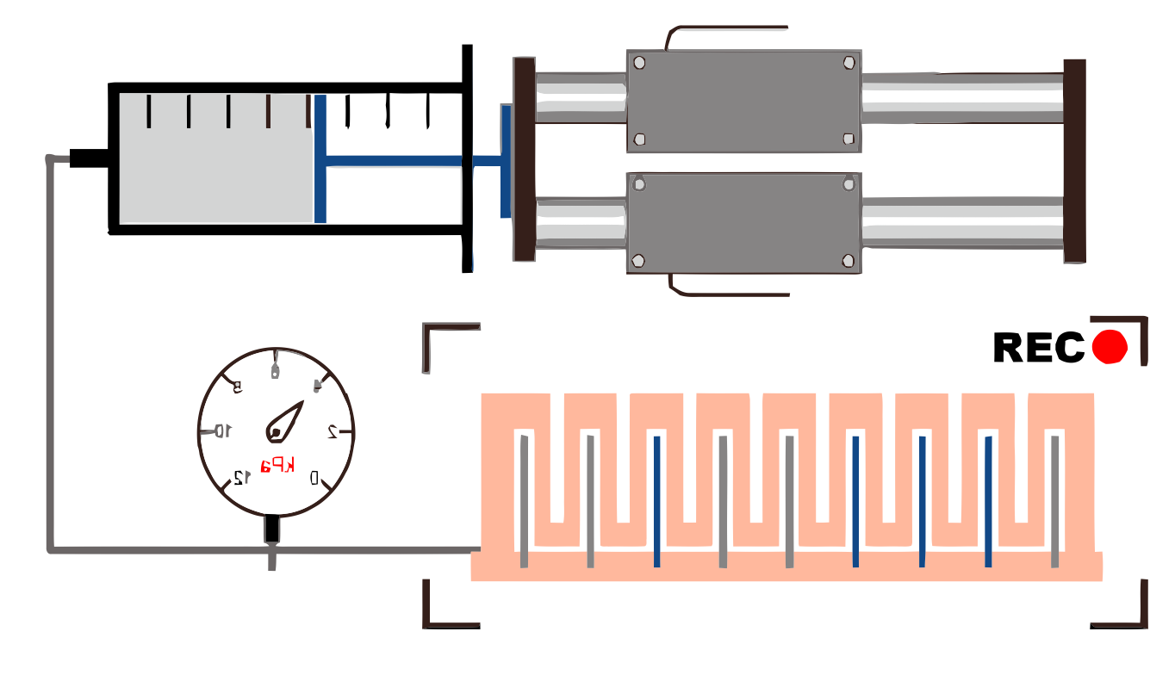
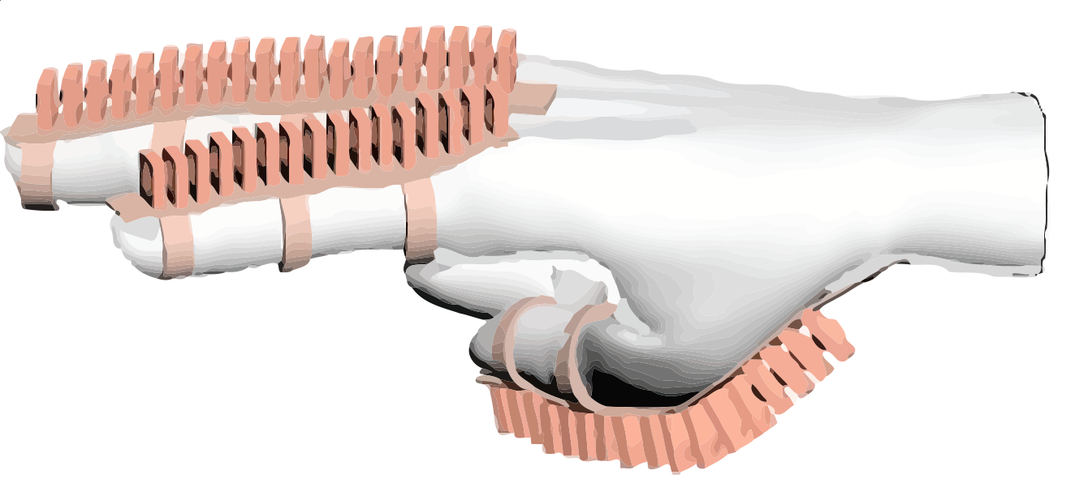
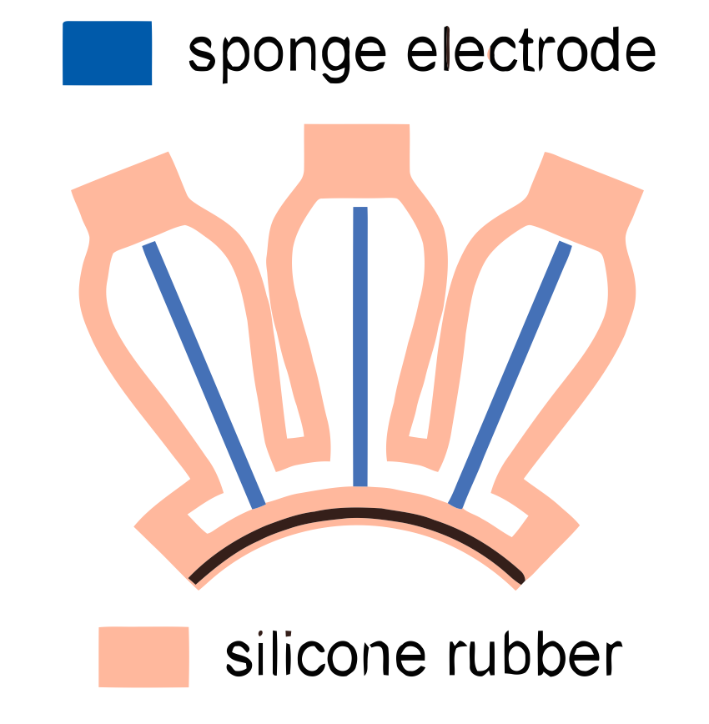
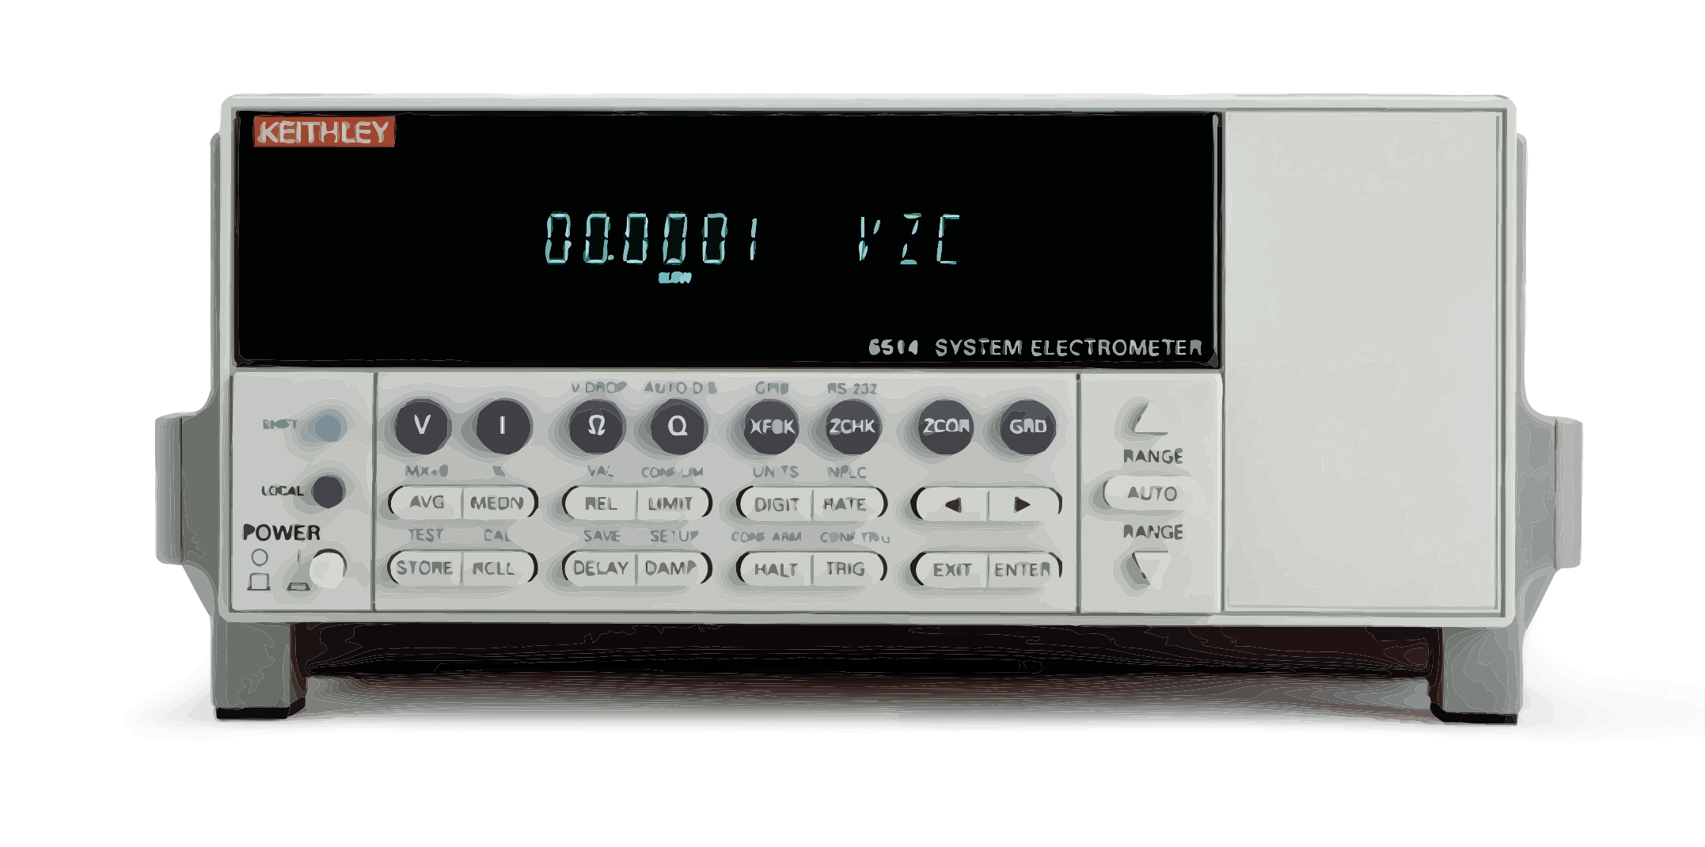
MATERIALS
Linear Motor Driven Syringe with
Air Gauge
Digital Camera
Soft Gripper
Sensorized PSAs
Keithley 6514 Electrometer
Assisting Glove
Notes:
Here you can see the study’s materials of interest.
To provide a pneumatic source, the researchers used a syringe driven by a linear motor. This system also had an air gauge to measure pressure and a digital camera to record PSA shape.
Note that sensorized PSAs were fabricated from silicone rubber and air permeable nickel sponge electrodes.
To measure open circuit voltage, closed circuit current, and the transfer of charge they used a Keithley 6514 electrometer.
From the sensorized PSAs, the group applied their technology by demonstrating a soft gripper and an assisting glove.

Slide 10






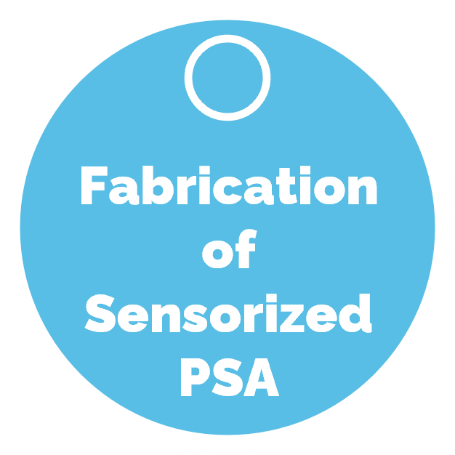
METHODS
Compared to Simulation
Tested Continuous Use
Tested Impact of Water
Performance Testing of Sensorized PSA
Incrementally Pumped Gas while
Floating Sideways
Pressure
Angle
Voltage
Charge
Suspended
Voltage
Angle
Demonstration of
Assisting Glove
Performance Testing of the System
Joint Voltage
Thumb
Index
Single Middle TENG
Pressure
Angle
Voltage
Average Voltage
10 TENG
Floating Sideways
Flat
Segments
3 - Thumb
5 - Index
Investigation of
Sensors for Piecewise PSA
Demonstration of
Soft Gripper
Analyzed Voltage Vs. Time
Small Cup
Medium Cup
Large Cup
Weighted Large Cup
Notes:
Now, don’t get intimidated by this slide. It’s just a summary of every method in the paper. We’ll see experiments 1 thru 5 again in the results section. What really concerns us here is the fabrication of Sensorized PSAs, which is that little blue circle in the middle. Step 0, let’s take a closer look at that.

Slide 11


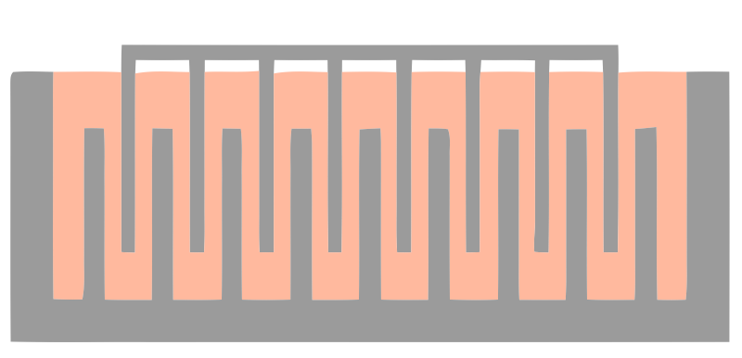

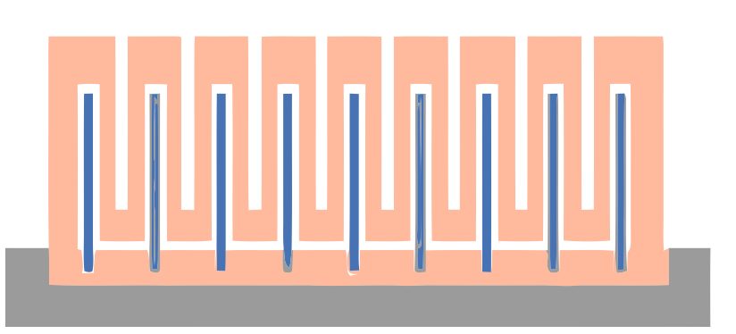
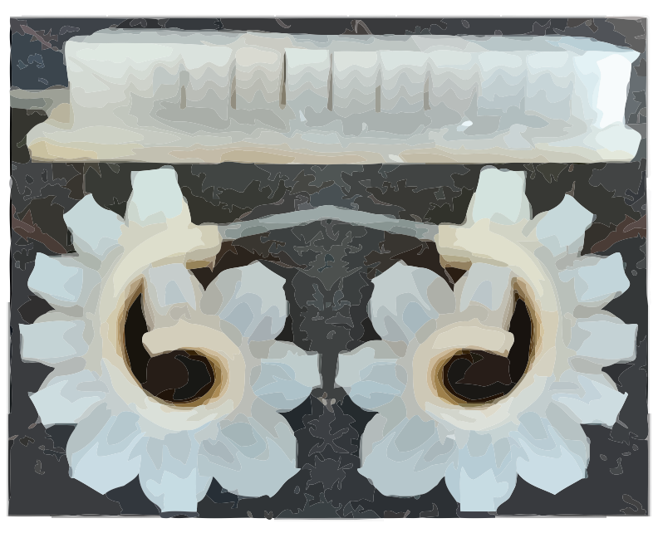
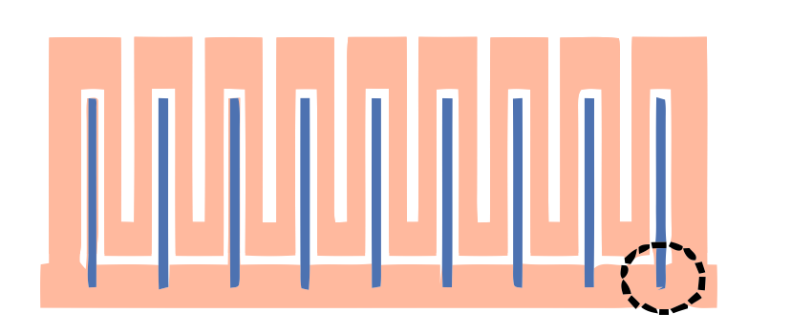
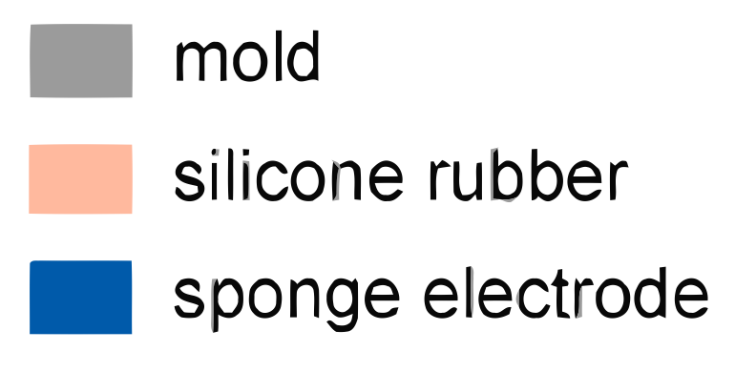
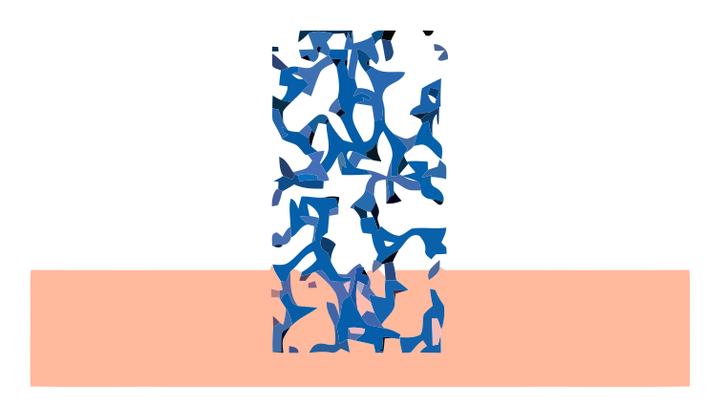
2. Demolding
3. Electrode Placement
4. Fix
to Bottom
1. Molding
Fabrication of
Sensorized PSA
Final Product
5. Demolding
Notes:
What you see here is the typical series of molding and de-molding steps for PSAs, albeit with the addition of electrode placement in step 3. That’s where the magic happens.

Slide 12

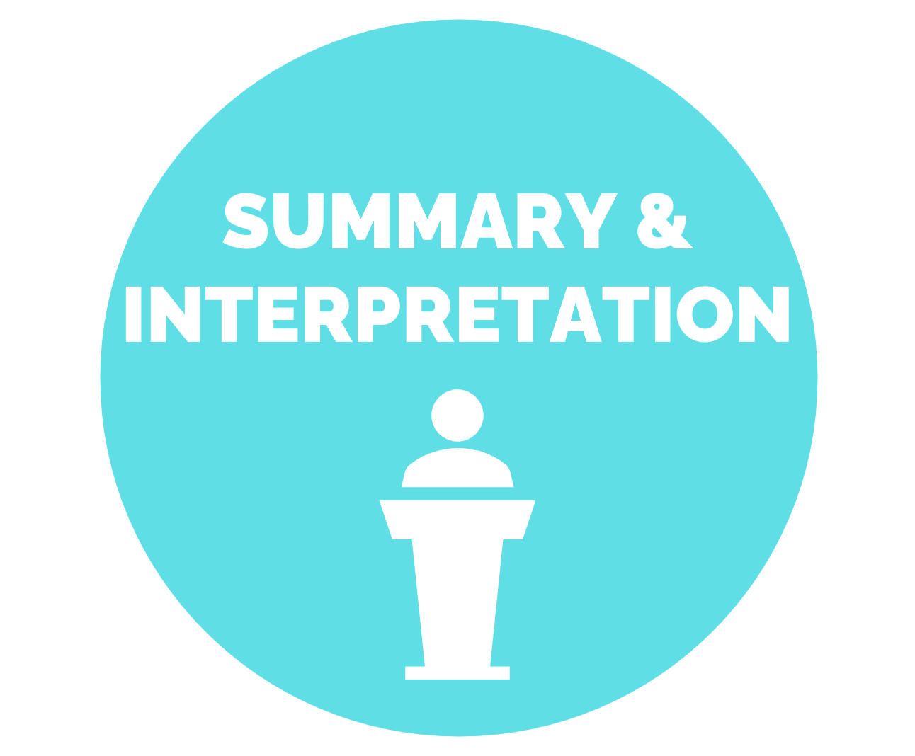
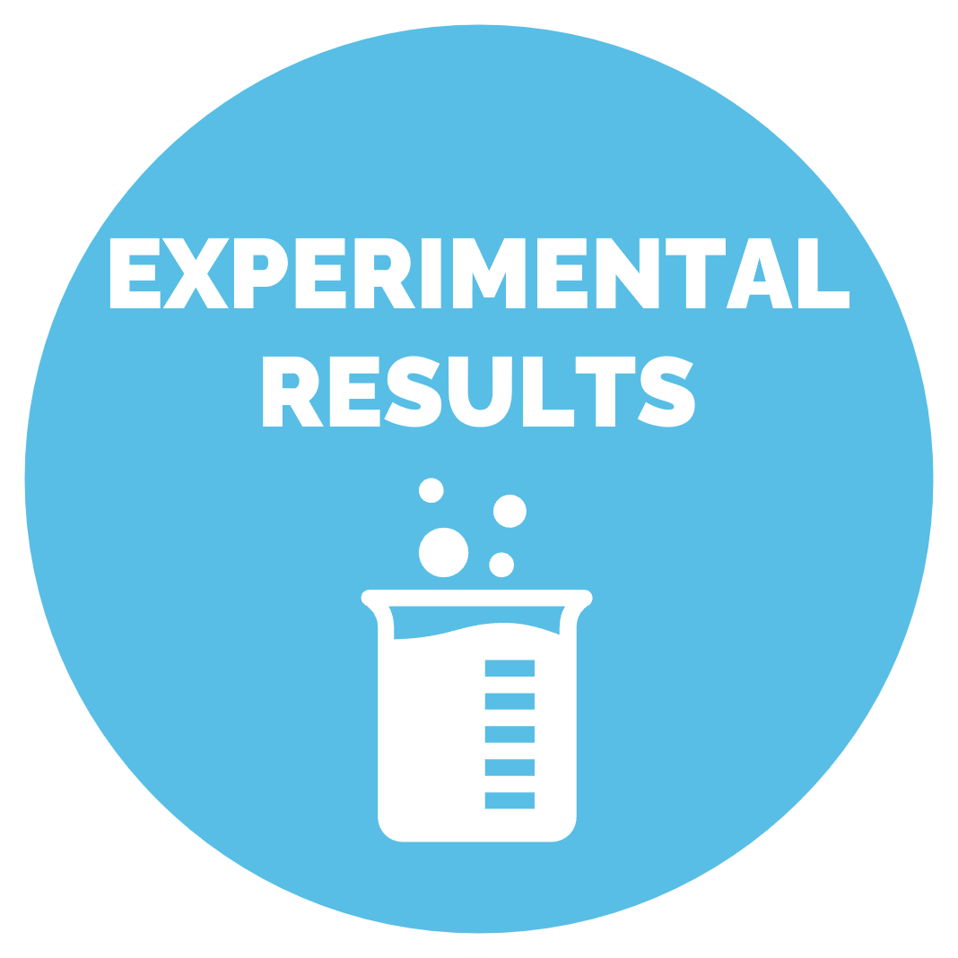
RESULTS & DISCUSSION

Slide 13

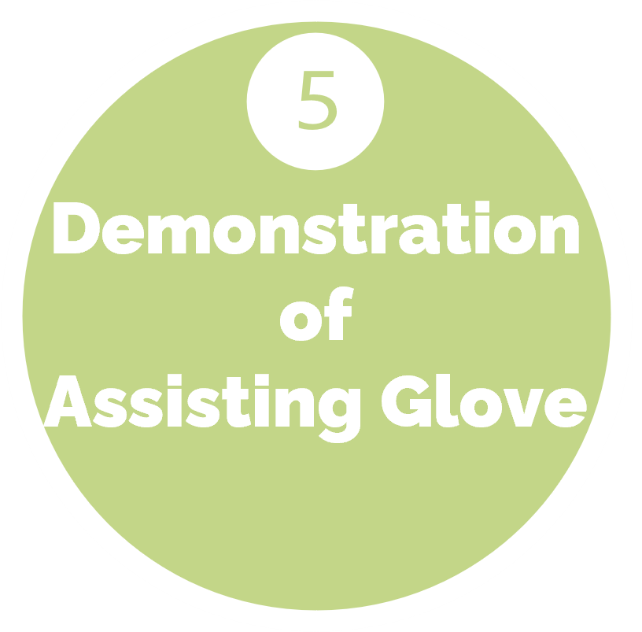
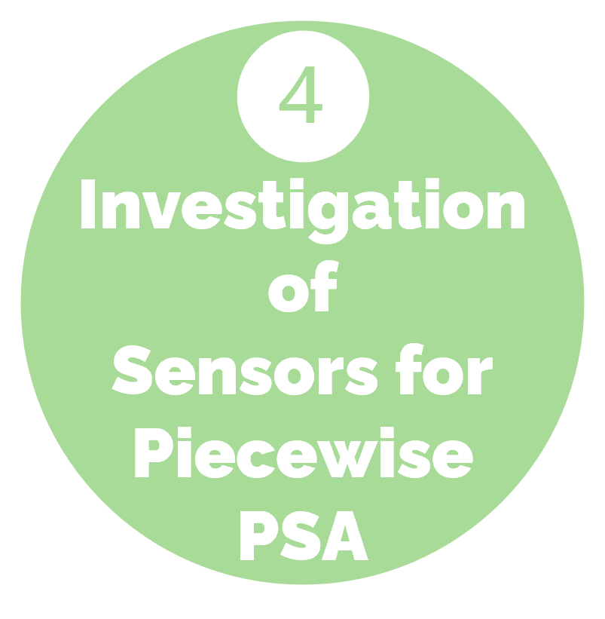
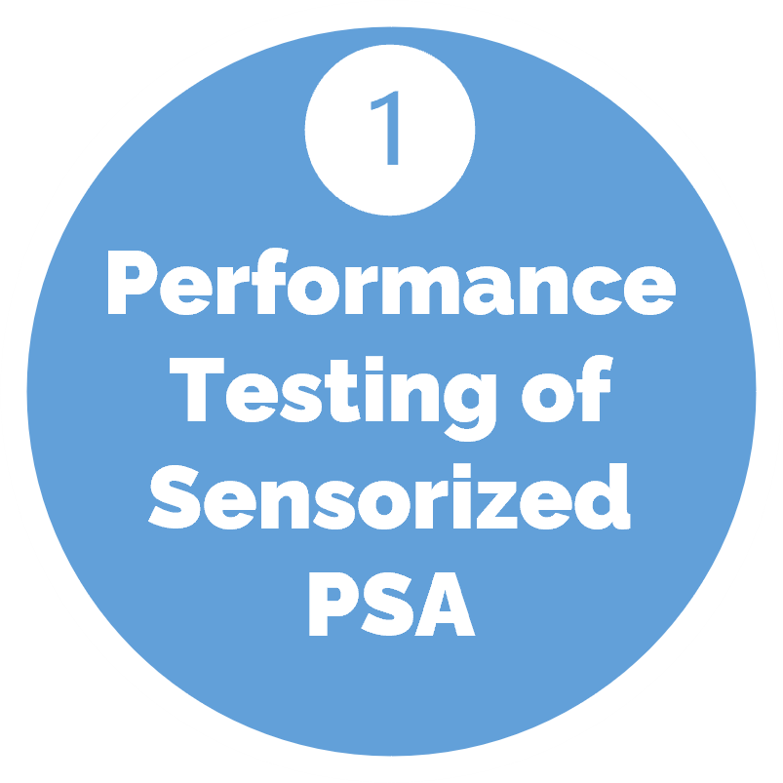
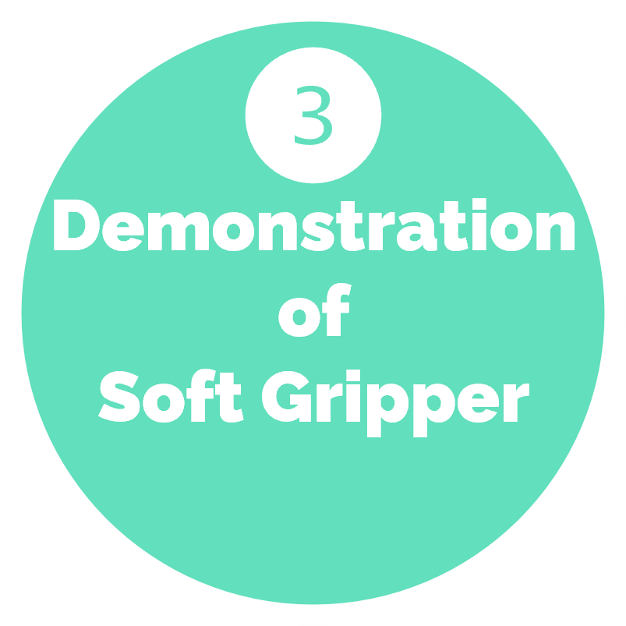
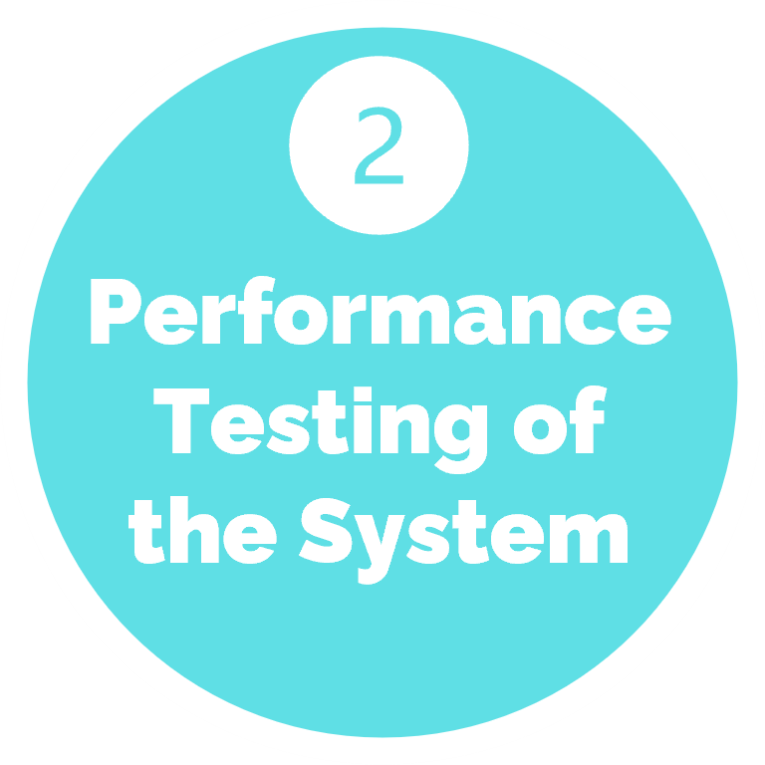
EXPERIMENTAL RESULTS
Notes:
See, here are those experiments again. Let’s examine them in closer detail.

Slide 14

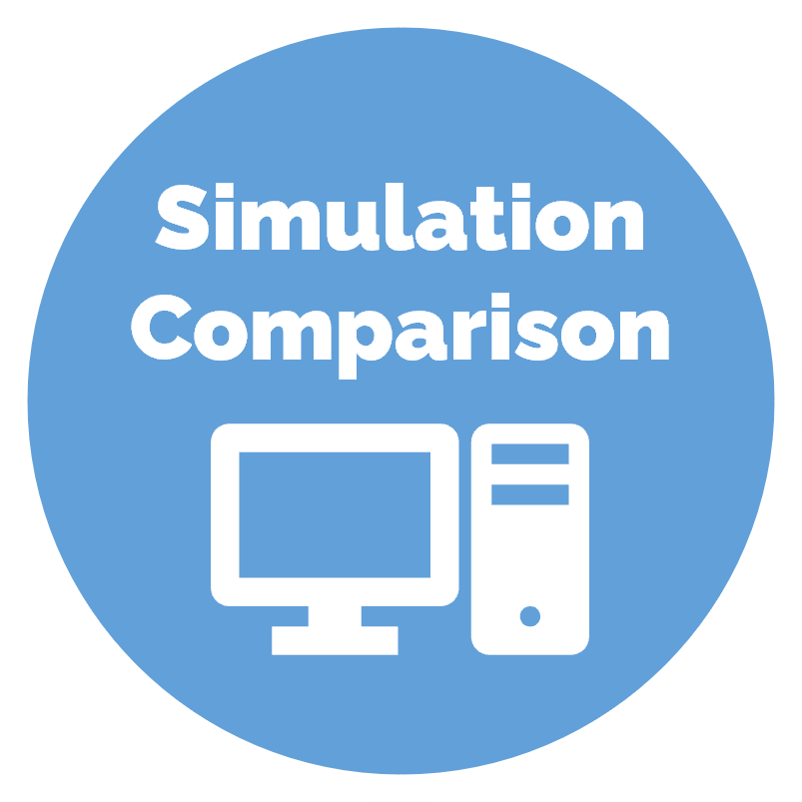
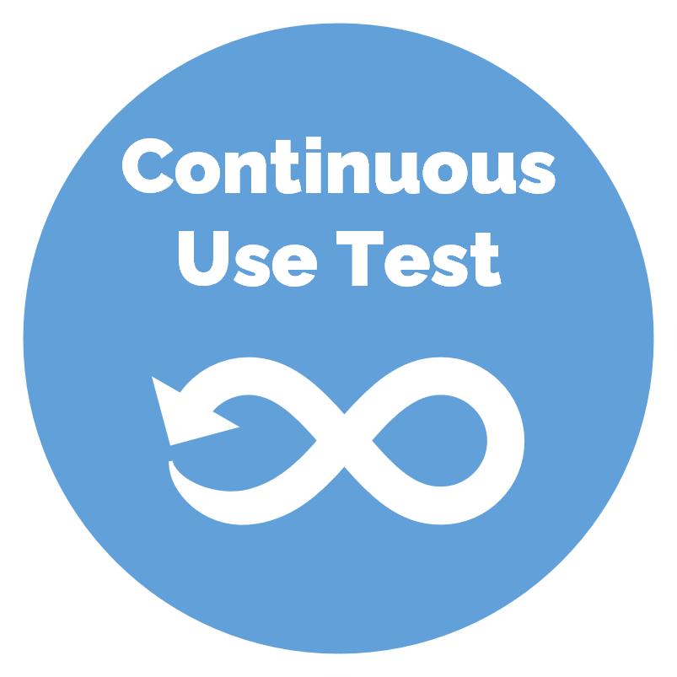
Performance Testing of Sensorized PSA
Notes:
The first series of experiments consisted of testing the performance of a single sensorized PSA.

Slide 15
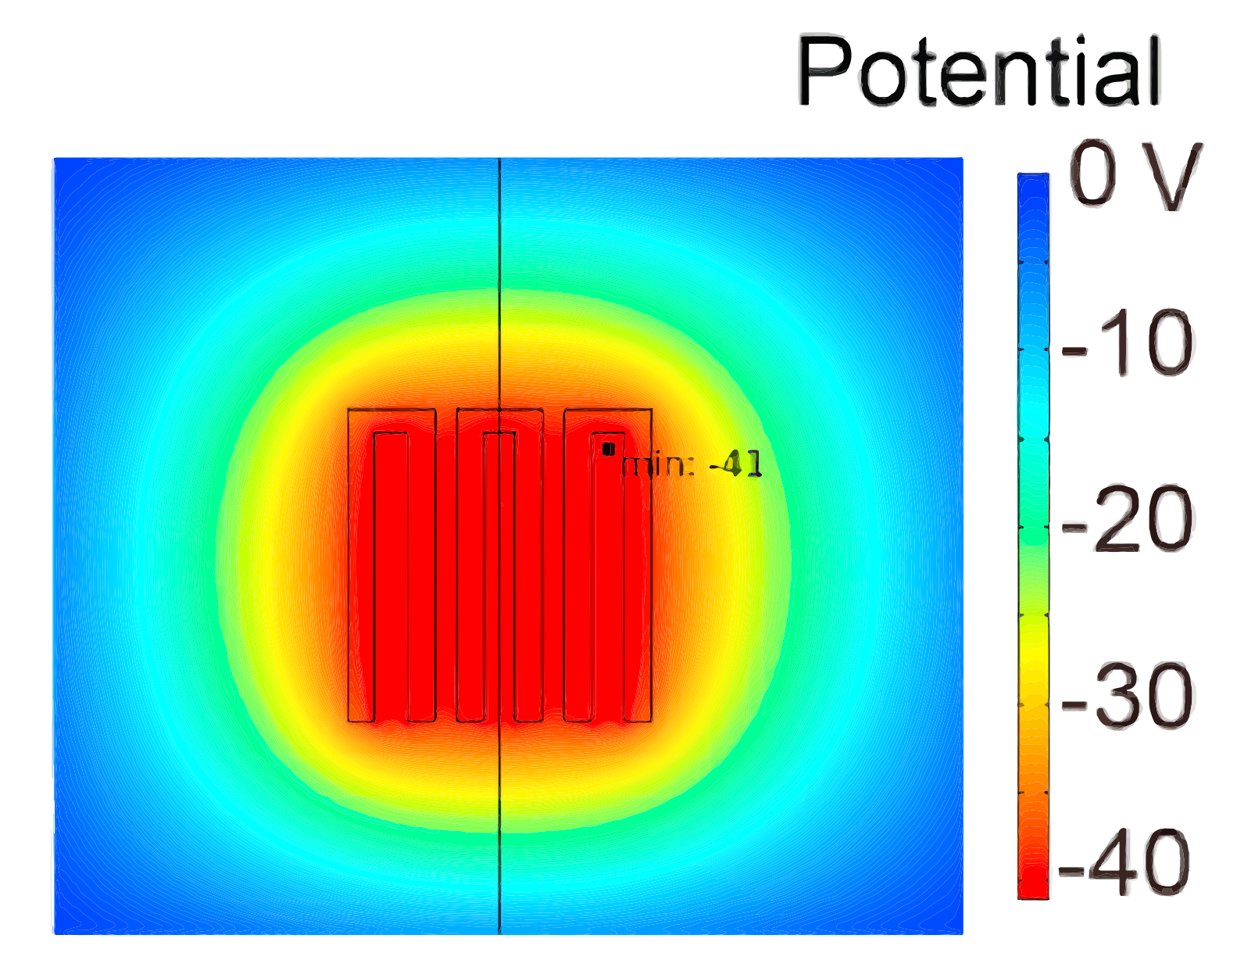
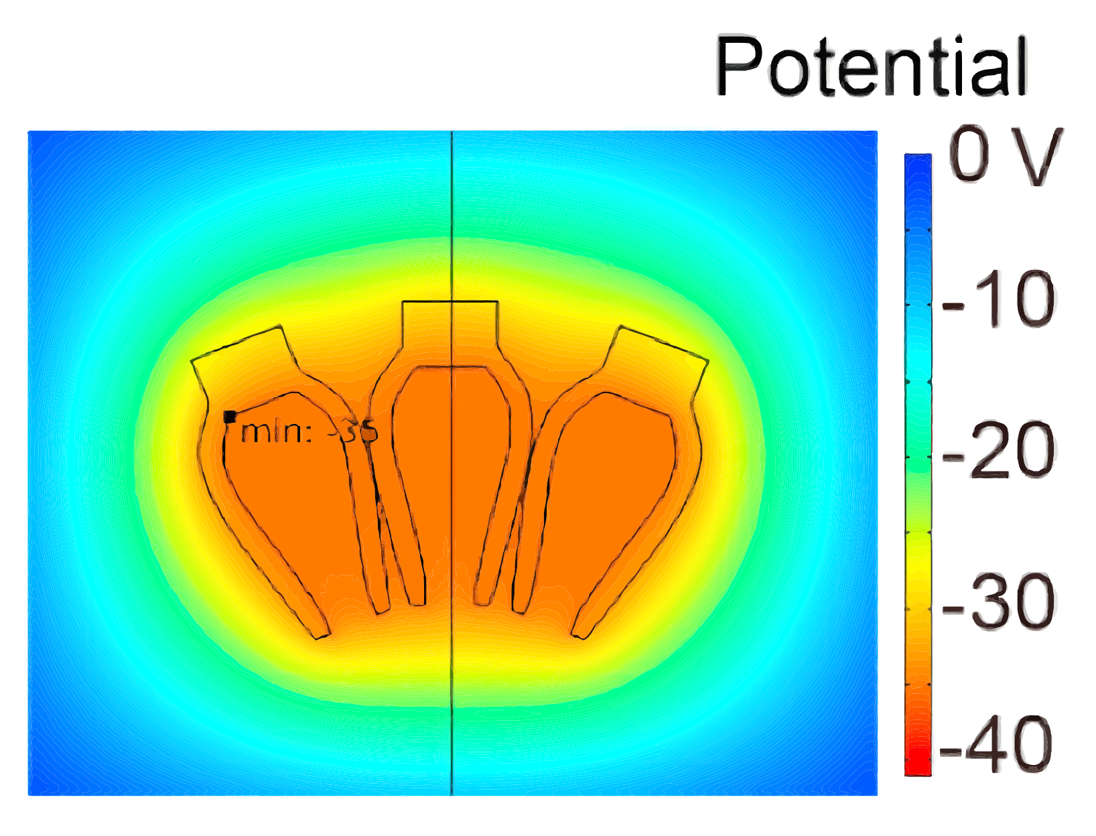


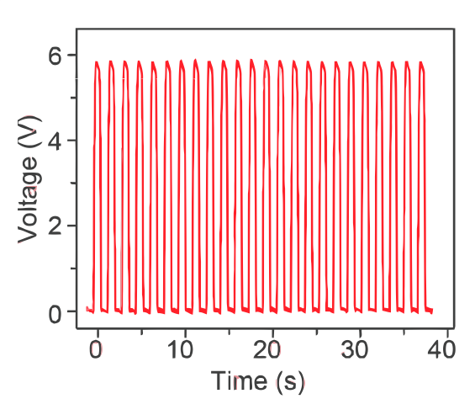
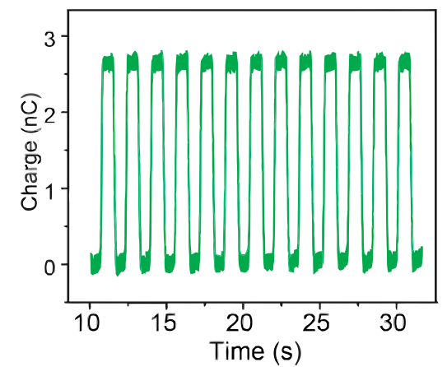

Simulation
-2[nC] Surface
-41 [V] Contacted
-35 [V] Separated
~6 [V] Potential Difference
Simulation
Simulation Comparison
Experiment
2.5 [nC] Transfer
5.7 [V] Peak Voltage
∴ Simulation Approximates The System
Experimental
Notes:
With respect to the simulation comparison, they estimated the electrostatic potential distribution via Finite Element Software and then compared the results to experimental values. Basically, what they found was that the simulation was a close approximation.

Slide 16
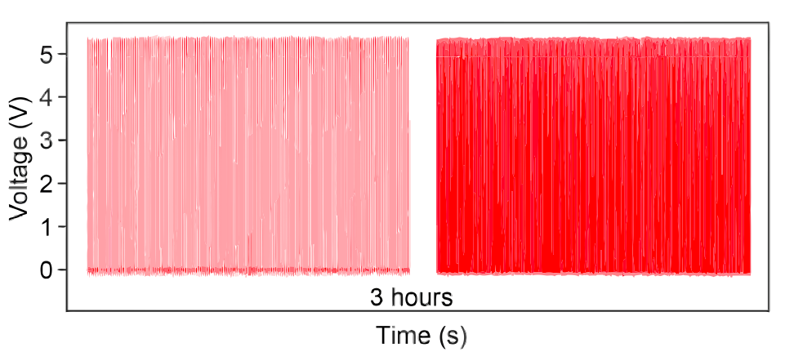

To test the stability
Linear Motor Set to Reciprocating Motion
3 h (~7500 cycles) Continuous
TENG:
~5.5[V]
No Obvious Attenuation
PSA:
Did not Fail
Continuous Use Test
∴ PSA and TENG have good stability.
Notes:
To test the stability of the sensorized PSA, the group set the system’s linear motor to provide periodic pneumatic pressure for 3 hours. They recorded Open-circuit voltage of the TENG, which was stable at about 5.5 [V]. Since neither the PSA nor the TENG failed, they conclude that both have good stability.

Slide 17

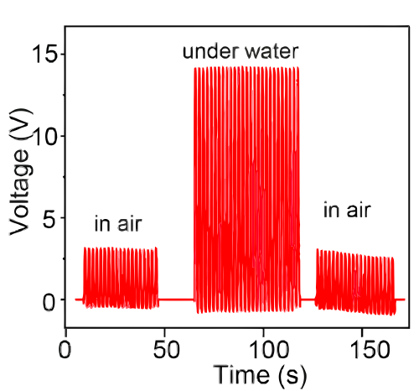

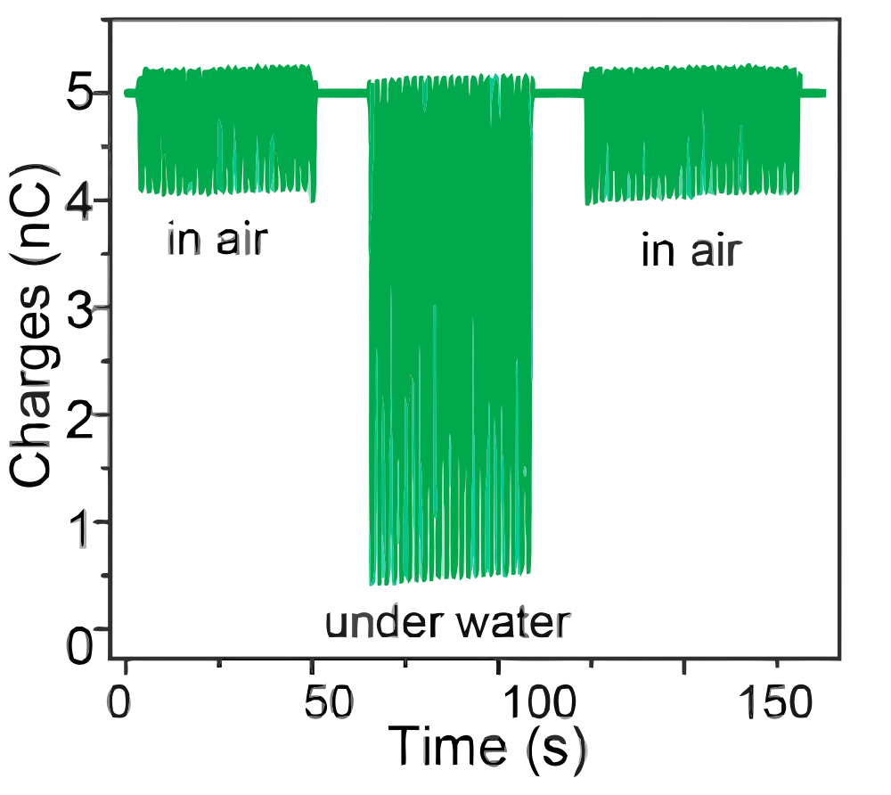
Submersion: Before & After
3[V] - Peak
1[nC] - Transfer
No Difference
Humidity has no Impact
Impact of Water
Submersion: During
15[V] - Peak
4.5[nC] - Transfer
Output Enhancement
Water acts as Electrode
Notes:
The group also tested if humidity or water had an impact on performance. They found that peak voltage and charge transfer were equal before and after water submersion, but during submersion both were approximately multiplied by a factor of 5. Thus, humidity has no impact, but engulfing the sensorized PSA in water enhances output.

Slide 18


Performance Testing of the System
Notes:
In the second series of experiments, they test the performance of a system of sensorized PSAs while floating them sideways, to lessen external forces, and suspending them in air to see the impact of gravity.

Slide 19
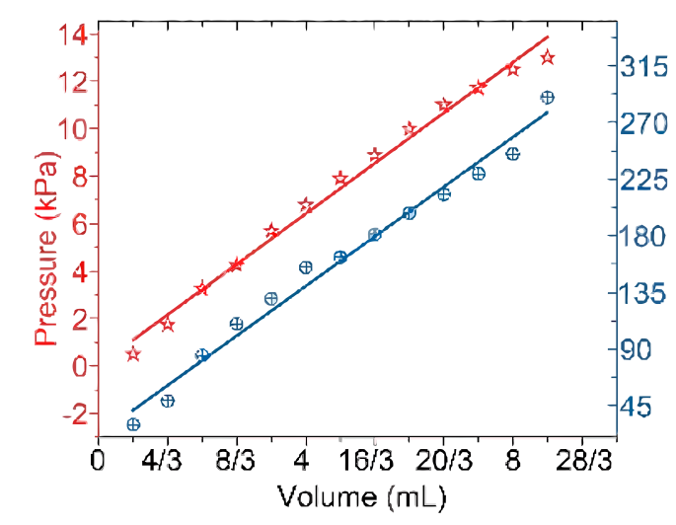
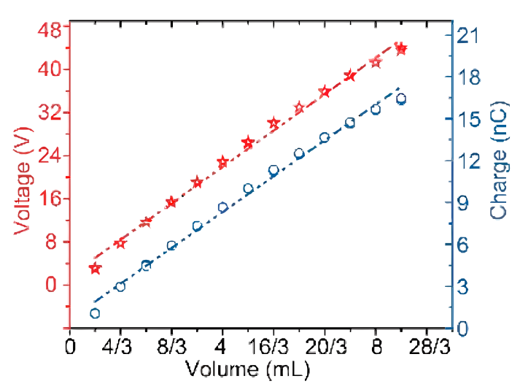

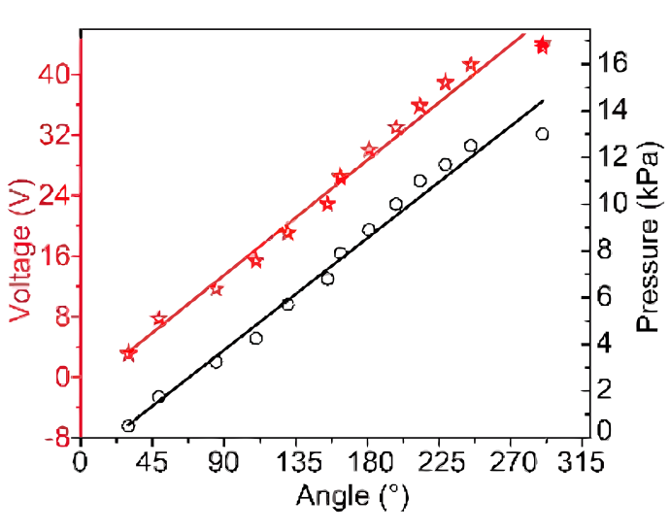
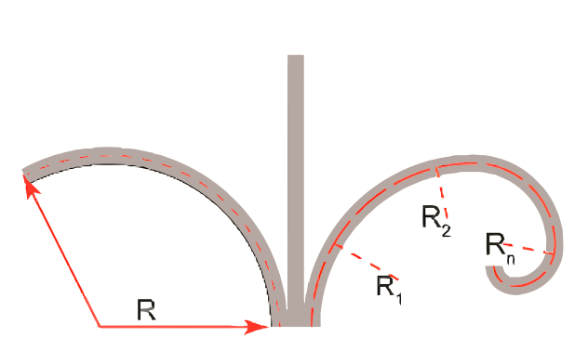
Floating Sideways
2/3 [mL] Increments
PSA freely bent into a perfect arc
Constant Curvature
PSA’s tip is a function of bending Angle and PSA Length
Good Linearity
1.59 [kPa/mL]
5.05 [V/mL]
0.17 V/°
Notes:
While floating the system sideways, they incrementally pumped gas and recorded the changing volume, pressure, angle, voltage, and charge. Without the influence of friction and gravity, the PSA fits a constant curvature model. Because length is known, and there is a linear relationship between voltage and angle, the position and orientation of the PSA’s tip can be derived. So, the system has something like awareness of its own shape. In other words, it has proprioception.

Slide 20
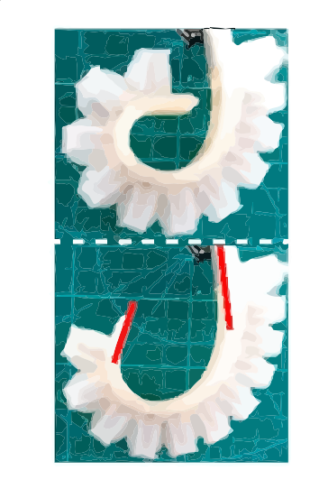

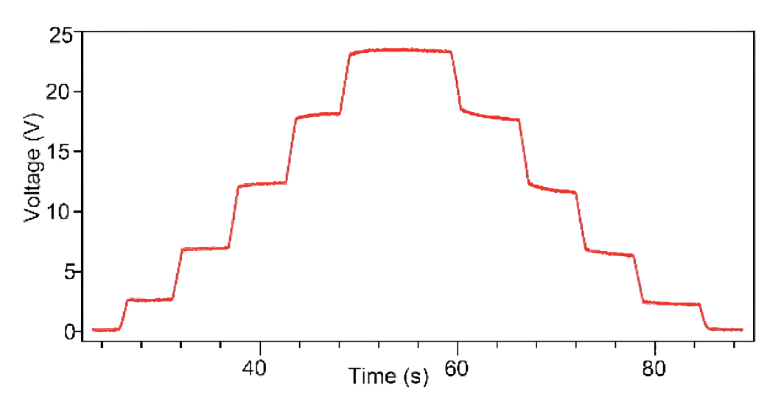
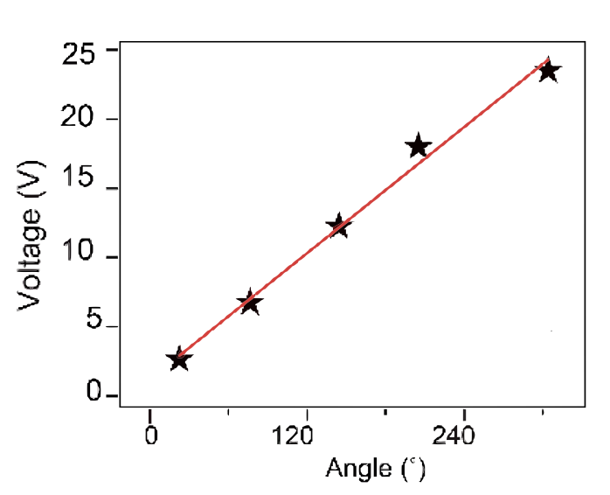
Suspended
10/3 [mL] Increments
Quick Dynamic Response
High repeatability
Helix Shaped
Piecewise Constant Curvature model
Linear Relationship
0.076 V/°
Notes:
Unfortunately, gravity is a factor with most applications of this technology. Thus, they ran a similar experiment with the system suspended in air but focused on voltage and angle. Although it did not fit a constant curvature model, they note quick response, high repeatability, and a linear relationship between voltage and angle.

Slide 21

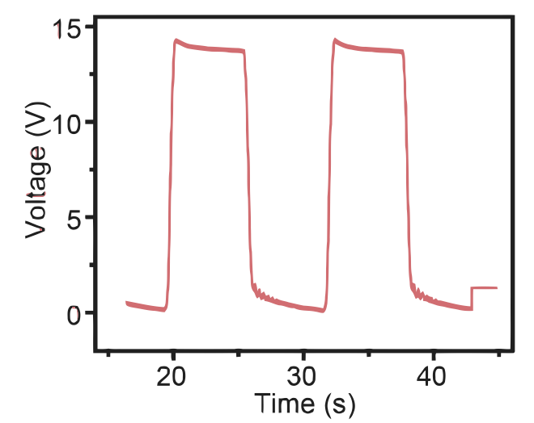

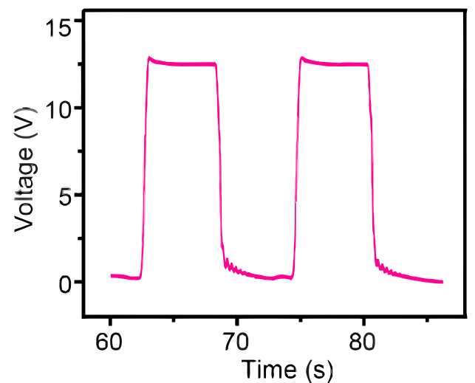
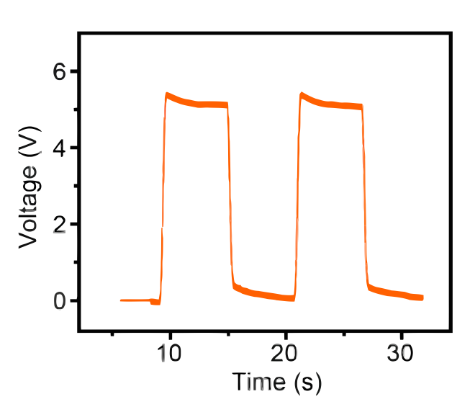

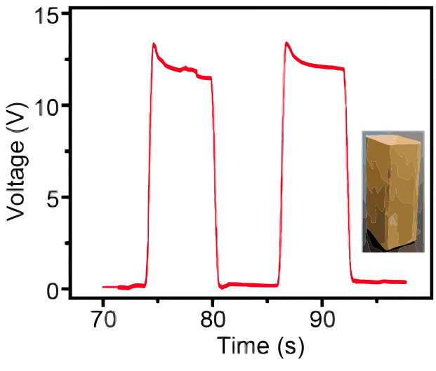

SMALL
DIA: 30[mm], θ: 65°, Vpeak: 14[V], Vfall: 2[V]
MEDIUM
DIA: 85[mm], Vpeak: 12[V]
Demonstration of
Soft Gripper
LARGE
DIA: 135[mm], Vpeak: 5[V]
WITH
WEIGHT
Cu: 36[g]
DIA: 135[mm] Vpeak: 11[V]
Notes:
To demonstrate their sensorized PSA as a universal gripper, they had it hold and drop cups with increasing diameter. Also, they ran an experiment where they put a copper weight in the largest cup. Looking at the graphs one can see the high sensitivity of the gripper. Also, aside from the last test with the copper weight, an increase in diameter led to a decrease in voltage due to a smaller bending angle. However, when weight was added voltage increased due to a need for more pressure. Overall, these results indicate the gripper can grab different sized objects and evaluate them in terms of diameter or weight.

Slide 22
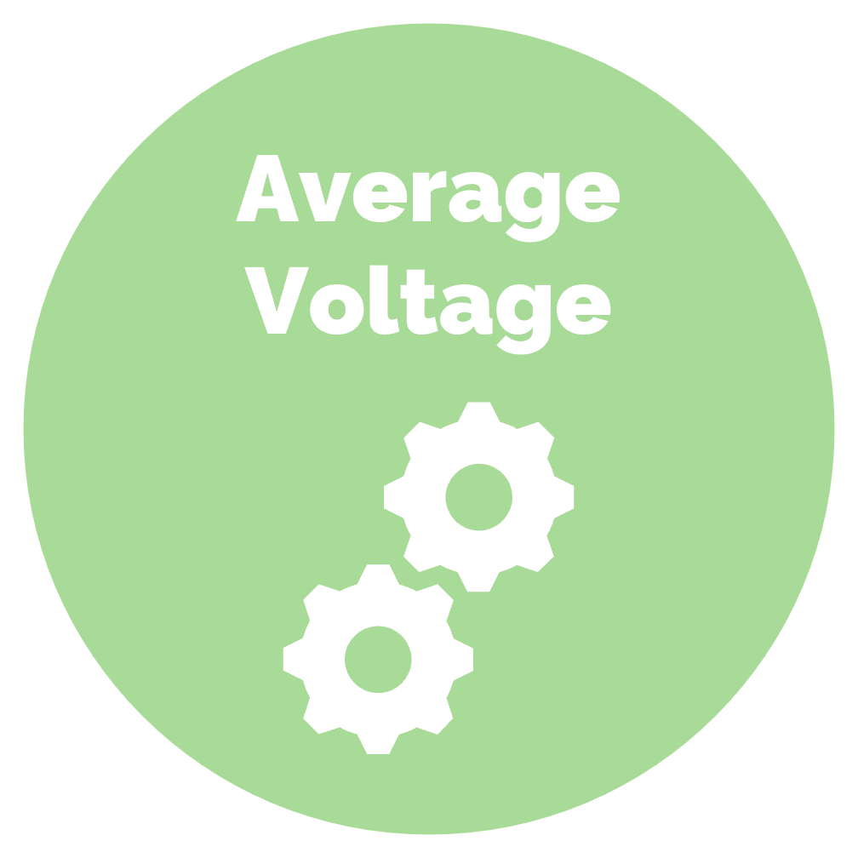

Investigation of
Sensors for Piecewise PSA
Notes:
Since the influence of gravity cause a Piecewise Constant Curvature model, they investigate segmented systems.

Slide 23
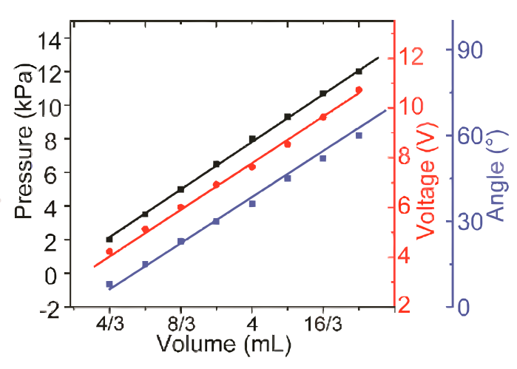

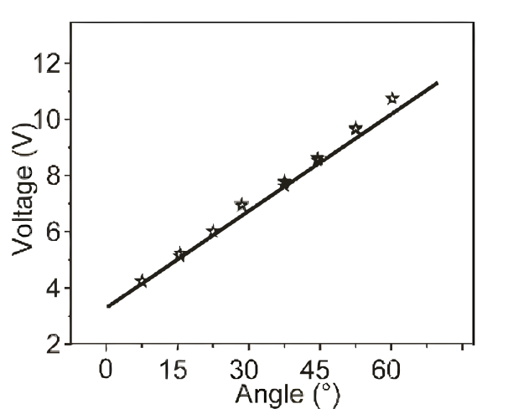
Side Floated
High Repeatability
Good Linearity
1.43 [V/mL]
0.1147°/V
TENG Sensor Performance is Stable and Repeatable
Single Middle TENG
Notes:
However, first, they tape all sensorized PSAs, save for the middle chamber, and removed gravity and friction via side floating. Once again, they incrementally increased gas volume and observed pressure, voltage, and bending angle. They note the high repeatability and good linearity of the single chamber .

Slide 24
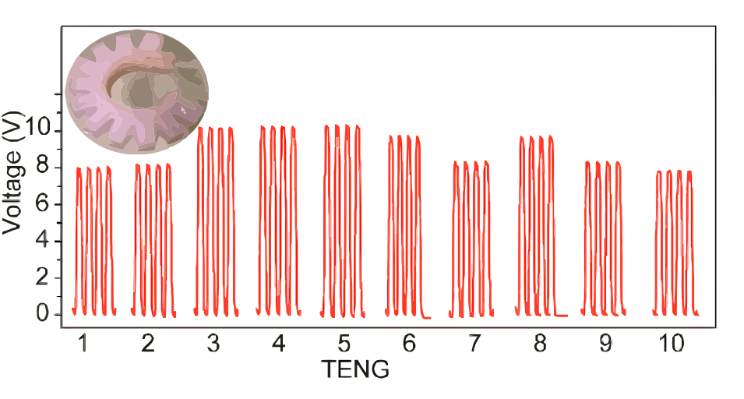
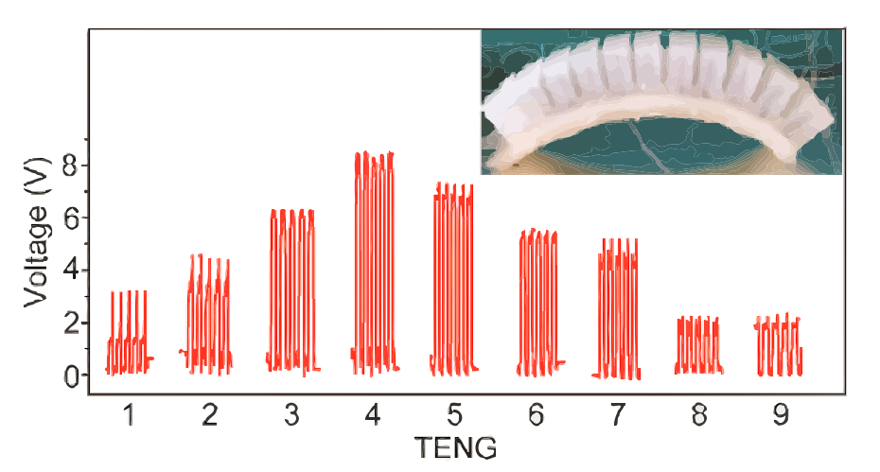

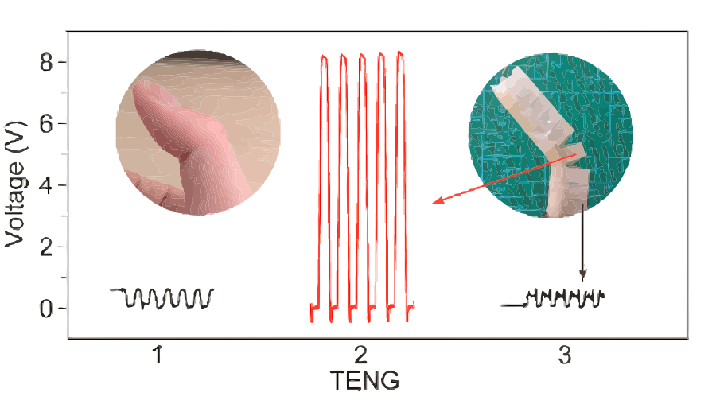
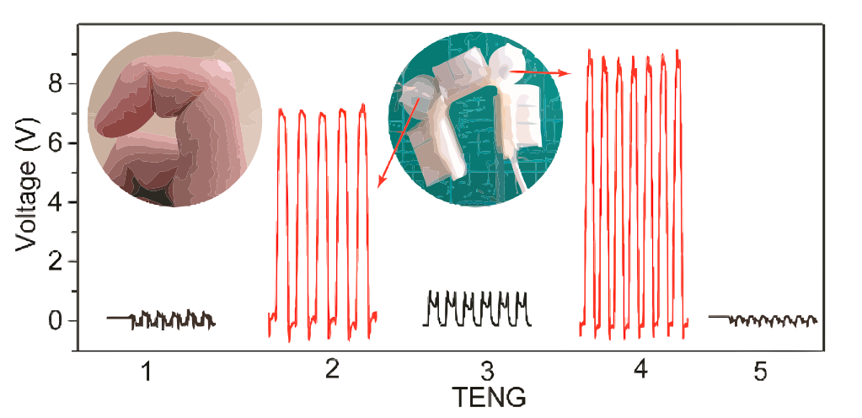
Floating Sideways
Flat
Average Voltage
Thumb
Floating Sideways
9[V] ± 1[V]
Constant Curve
Flat
Voltage Corresponding to Piecewise Curvature
Thumb
Part 1 and 3: 0.5[V]
Part 2: 8[V] & 44°
Index
Part 1, 3 and 5:
0.5[V], 1[V] & 0.5 [V]
Part 2 and 4:
7[V] & 9[V]
Index Finger
Notes:
Now, they finally examine the TENG performance of multiple segments under different conditions. Initially, they looked at a 10-segmented system while side floating and flat. For the floated system, voltage was near constant like the curve. On the other hand, the flat condition led to an arch with average voltage reflecting the shape. Next, they taped a 3 segmented system and a 5 segmented system to mimic a thumb and index finger. Ultimately, they found that output voltage reflects gesture.

Slide 25



Demonstration of
Assisting Glove
Notes:
To examine the potential application in wearable devices and robotic hands, the group’s last experiment involved an assisting glove that combined the thumb and index finger systems. Here the PSA guided the fingers to bend while the sensors gave feedback on the gesture.

Slide 26




~39°
~51°
Thumb
~9[V] when ~51°
~5[V] when ~39°
Notes:
At about 51 degrees, the 3 segmented thumb PSA had an output of 9 [V], which fell to 5[V] when the angle was reduced to approximately 39 degrees.

Slide 27




First Joint
Second Joint
First Joint: ~ Above 10 [V]
Second Joint: ~Below 10[V]
Index
Notes:
Regarding the 5 segmented index finger, the voltage at the first joint was above 10 [V], which is slightly larger than the voltage of the second joint.

Slide 28

SUMMARY & INTERPRETATION
Sensorized PSAs
Self Powered
Modeled by Finite Element Software (Voltage & Charge)
Stable & Repeatable Performance
Not Impacted by Humidity
Voltage Enhanced by Water Submersion
External Forces Removed
They have good linearity
They fit a Constant Curve Model
With Gravity Included
Segmented angles and voltage have a linear relationship
Follow a Piecewise Constant Curvature model
Dynamic, sensitive, & able to grab and evaluate objects of different sizes & weights
Able to Mimic Finger Gestures & Guide Hands
SUMMARY
INTERPRETATION
Sensorized PSAs can enable safe and adaptable Human-Machine Interaction through self powered proprioception.
Notes:
Given the experimental results, it appears that Sensorized PSAs can enable safe and adaptable Human-Machine Interaction by endowing soft robots with proprioception. What’s more they can do so while generating electricity, which gives them an advantage over known competing technologies, like strain sensors.

Slide 29




QUESTIONS & ANSWERS

Slide 30





HUMAN RESOURCES

Slide 31
Syed Sheahan Ahmed^{[5]}
Research Intern
Production Associate
Tsunami Pinkney^{[6]}
B.S. Biology
Chemistry Minor
Bioinformatics and Genomics
Highly Experienced in Biomedical Microdevices
BME
Andres Hugo Bryan^{[7]}
Crystal Yarbrough^{[8]}
Knows soft robotics

Slide 32
Isaiah Farayola^{[9]}
Electromechanical Engineer
Telecommunication Engineering
Guangxia Feng^{[10]}
ECE
Erich McMillan^{[11]}
Honors College
Knows Dr. Dave
Yaping Shi^{[12]}

Slide 33
Jill DeVries^{[13]}
~ 3 Years in Medical Devices
Writing & Executing Design Verification/Validation Protocols
Assembling/Testing Medical Devices
MECH

Slide 34
Stephen Hejducek^{[14]}
B.S. Metallurgical Engineering
Materials Engineer
Specialist - Metallics
Technical Sales Engineer
MET E

Slide 35
References
[1] Chen, J., K. Han, J. Luo, L. Xu, W. Tang, and Z. Wang. Soft robots with self-powered configurational sensing. Nano Energy 77:105171, 2020.
[2] Nature Research. 2021 tables: Institutions | 2021 tables | Institutions | Nature Index. , 2021.at https://www.natureindex.com/annual-tables/2021/institution/all/all
[3] Georgia Tech. Zhong Lin Wang | Materials Science and Engineering. , 2021.at http://www.mse.gatech.edu/people/zhong-lin-wang
[4] Sener Videos. Best Robot Fails Compilation | Sener Videos #1. , 2021.at https://www.youtube.com/watch?v=tSw5oIyAlKM
[5] Ahmed, S. Syed Sheahan Ahmed. , 2021.at https://www.linkedin.com/in/syed-sheahan-ahmed
[6] Pinkney, T. Tsunami Pinkney. , 2021.at https://www.linkedin.com/in/tsunami-pinkney-433b27131/
[7] Bryan, A. Andres Bryan. , 2021.at https://www.linkedin.com/in/andres-bryan/
[8] University of Houston. Graduate Students. , 2021.at http://www.bme.uh.edu/people/graduate-students
[9] Farayola, I. Isaiah Farayola. , 2021.at https://www.linkedin.com/in/isaiah-farayola-7a4a58151/
[10] University of Houston. Campus Directory: Guangxia Feng. , 2021.at https://www.uh.edu/directory/index.php?emplid=MTk1MDg5Ng==&loc=HR730&dpt=H0070
[11] University of Houston. SHINE & RISE: 2017 ANNUAL REPORT. , 2021.at https://www.uh.edu/honors/about/news-events/annual-report/archives/shinerise_2017_low-res.pdf
[12] University of Houston. Campus Directory: Yaping Shi. , 2021.at https://www.uh.edu/directory/index.php?emplid=MTk2MzkxMw==&loc=HR730&dpt=H0070
[13] Jill DeVries. , 2021.at https://www.linkedin.com/in/jill-devries-6ab869133/
[14] Hejducek, S. Stephen Hejducek. , 2021.at https://www.linkedin.com/in/stephen-hejducek-0871915b/

